Slide 1
Hands-On PowerShell for Active Directory
Joshua B Jones

Slide 2
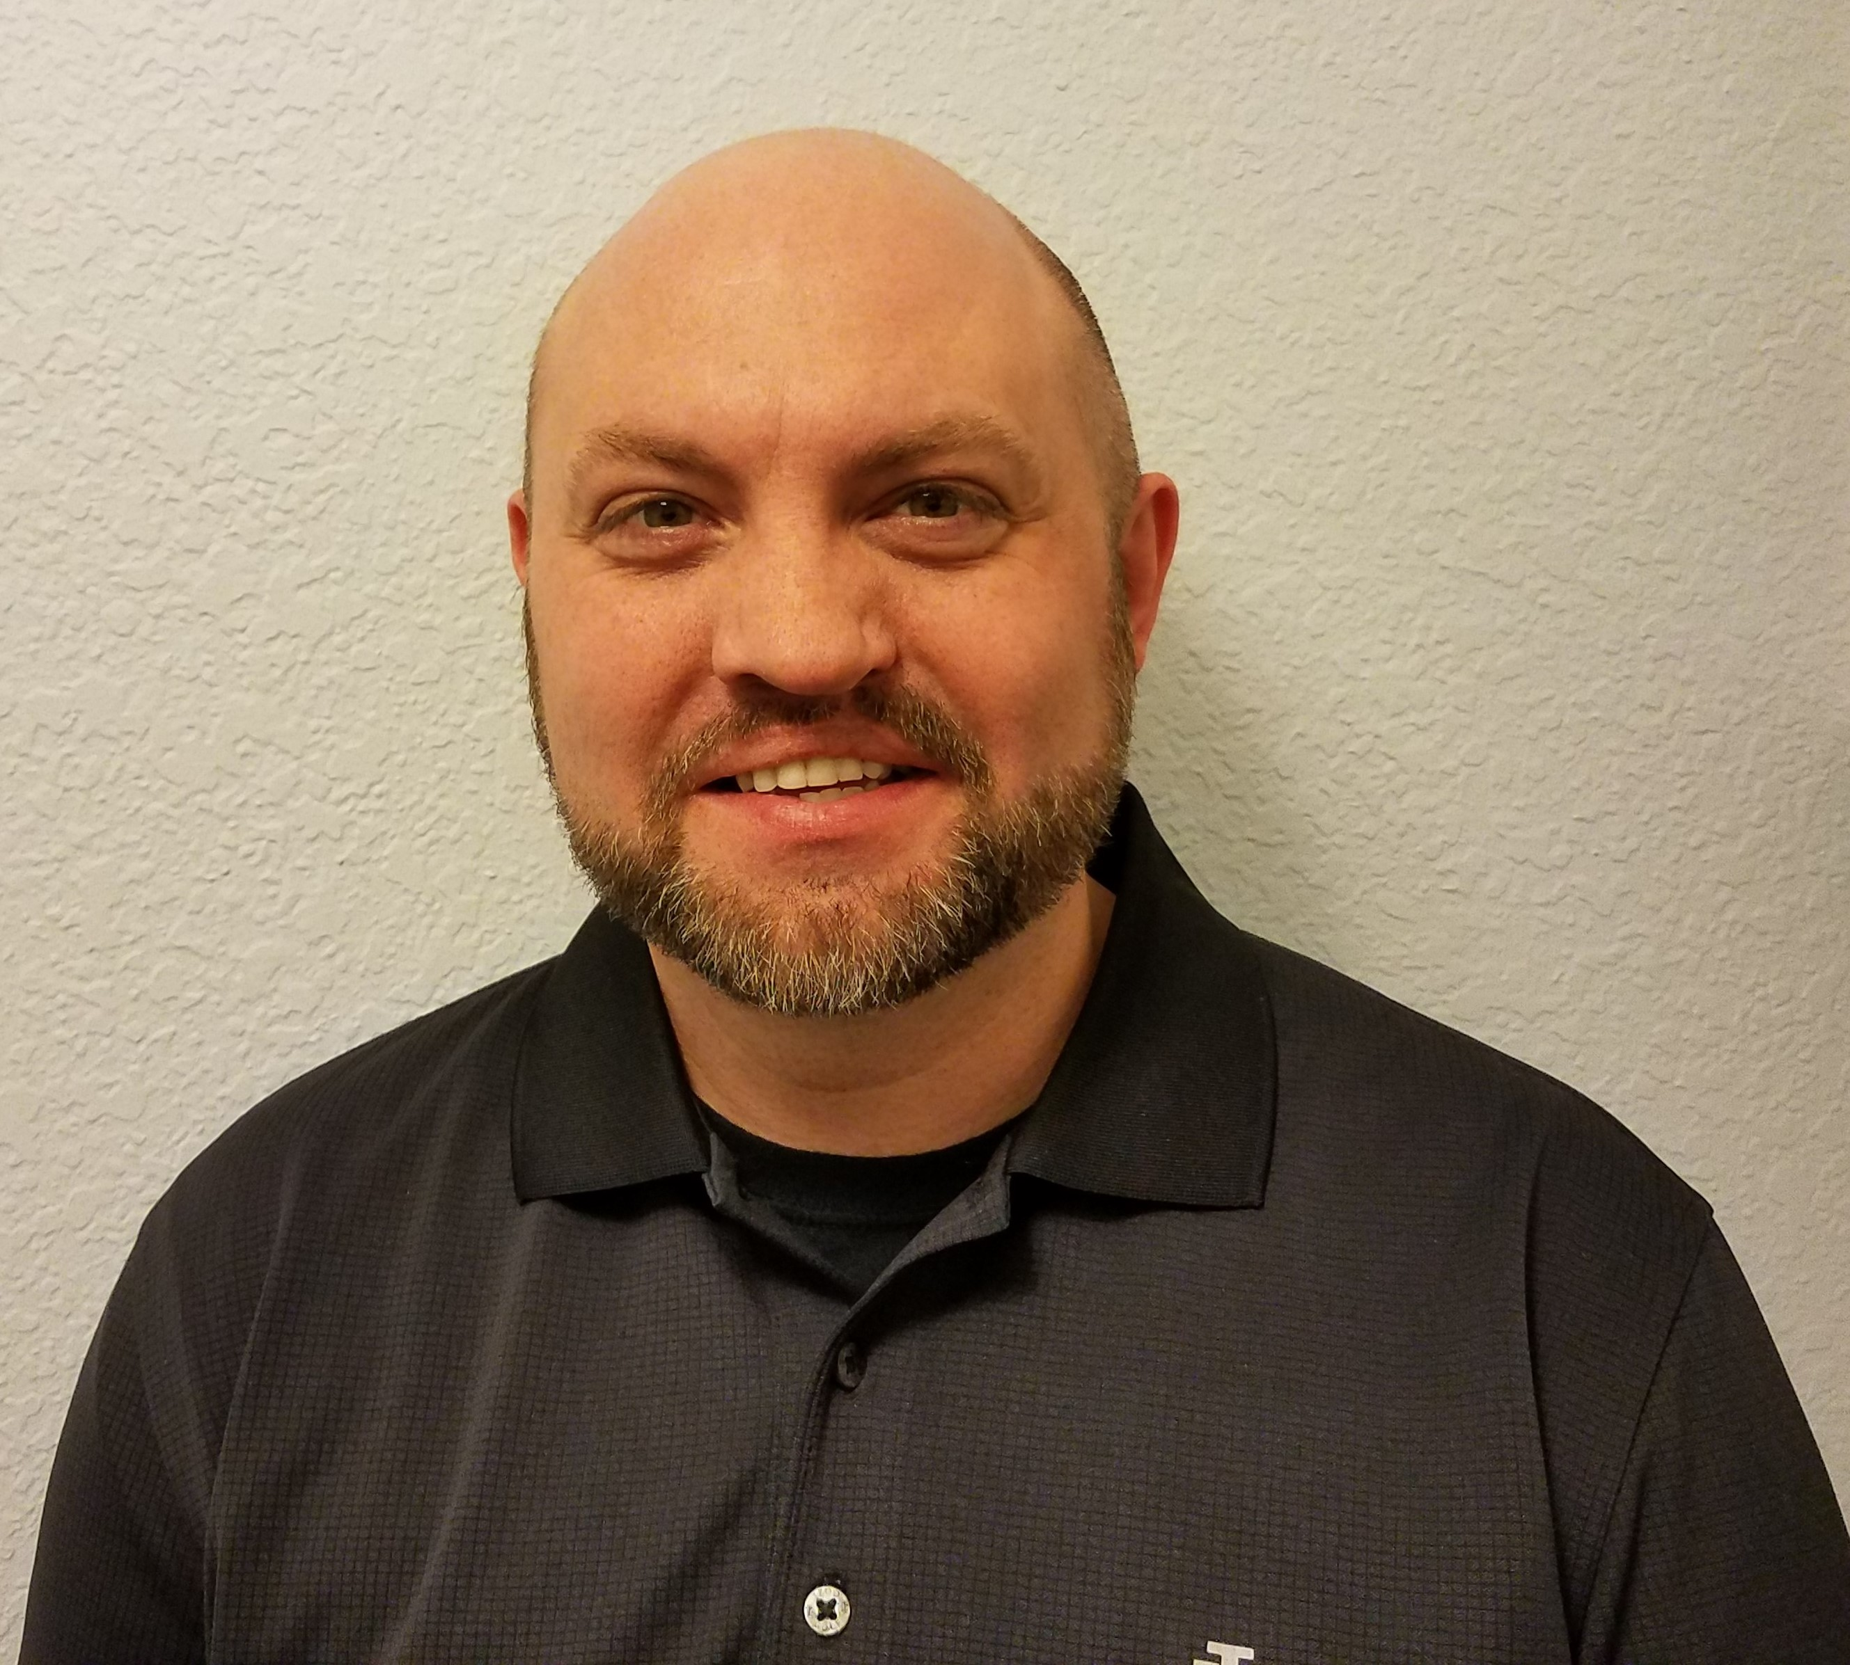
Joshua B Jones
IT systems administrator in charge of PowerShell administration and tool creation for airways freight
Certified Microsoft professional and virtualization specialist
Eliminated thousands of hours of manual labor with PowerShell
Trained hundreds of students

Slide 3
The Course Overview

Slide 4
What We’ll Learn?
Section 1
Building Labs for Active Directory and PowerShell Testing

Slide 5
What We’ll Learn?
Section 1
Section 2
Building Labs for Active Directory and PowerShell Testing
Navigate and Use PowerShell with Active Directory Fluently

Slide 6
What We’ll Learn?
Section 1
Section 3
Section 2
Building Labs for Active Directory and PowerShell Testing
Report Creation for Your Active Directory
Navigate and Use PowerShell with Active Directory Fluently

Slide 7
What We’ll Learn?
Section 1
Section 3
Section 2
Building Labs for Active Directory and PowerShell Testing
Report Creation for Your Active Directory
Section 4
Navigate and Use PowerShell with Active Directory Fluently
DHCP, DNS, Group Policy, and Basic AD Tools

Slide 8
What We’ll Learn?
Section 1
Section 3
Section 5
Section 2
Building Labs for Active Directory and PowerShell Testing
Report Creation for Your Active Directory
Working with Scripts, Functions, and Custom Modules for AD
Section 4
Navigate and Use PowerShell with Active Directory Fluently
DHCP, DNS, Group Policy, and Basic AD Tools

Slide 9
What We’ll Learn?
Section 1
Section 3
Section 5
Section 2
Section 6
Building Labs for Active Directory and PowerShell Testing
Report Creation for Your Active Directory
Working with Scripts, Functions, and Custom Modules for AD
Section 4
Navigate and Use PowerShell with Active Directory Fluently
DHCP, DNS, Group Policy, and Basic AD Tools
Solving Real-World Active Directory Problems with PowerShell

Slide 10
Prerequisites
Basic understanding and experience with active directory
A computer with enough resources to facilitate a virtual lab environment
Any modern OS (Windows, Mac, or Linux)
8 GB minimum RAM, 16 GB recommended RAM
i5 or better CPU recommended
Minimum of 120 GB disk space (external HD will work fine)
Software is all included with Windows

Slide 11
Willingness to Learn
Commit the time
Commit to using a lab
Commit to using PowerShell daily in production
Commit to connecting

Slide 12
Let’s Get Started!

